Slide 1
Making Time
Making time and space in the Visual Arts for deep change

Slide 2
Making Time
Making time and space in the Visual Arts for deep change

Slide 3
RECAP
The AREVA project was initiated following increasing reports and whistleblowing of racist incidents experienced by artists and cultural workers in the sector, and the desire expressed by CVAN’s members to create a meaningful, proactive response to bring about change.
The project began with a set of knowledge exchanges between CVAN members in June-July 2022, leading to the publication of the AREVA Report in Jan 2023.
Following this, a next steps workshop was held in Mar 2023 which helped narrow in on priority issues and to develop a skeleton plan to be fleshed out.
This meeting reports back to workshop participants with a set of provocations and proposals for further input before presentation to the wider membership.

Slide 4
Overall Aims
(a quick reminder)
To enable organisations to:
1. Build coalition, friendship, and mutual in the sector.
2. Create governance models that systematically performs anti-racism.
3. Develop trauma-informed and transformative justice practices.
4. Explore ways of working that centre intersectionalities of lived experience.
5. Reform funding approaches so as to develop an anti-racist ecosystem in the sector.

Slide 5
How?
Phase 1: identify specific areas of concern (e.g., complaints process, policy writing) and devise projects to test solutions.
Phase 2: scope existing capacity of the organisations to meet regularly and to undertaking internal experiments and evaluations.
Phase 3: reflexive evaluation, and recommendations for reforming the relational structure and funding approaches of the (London sub) sector.

Slide 6
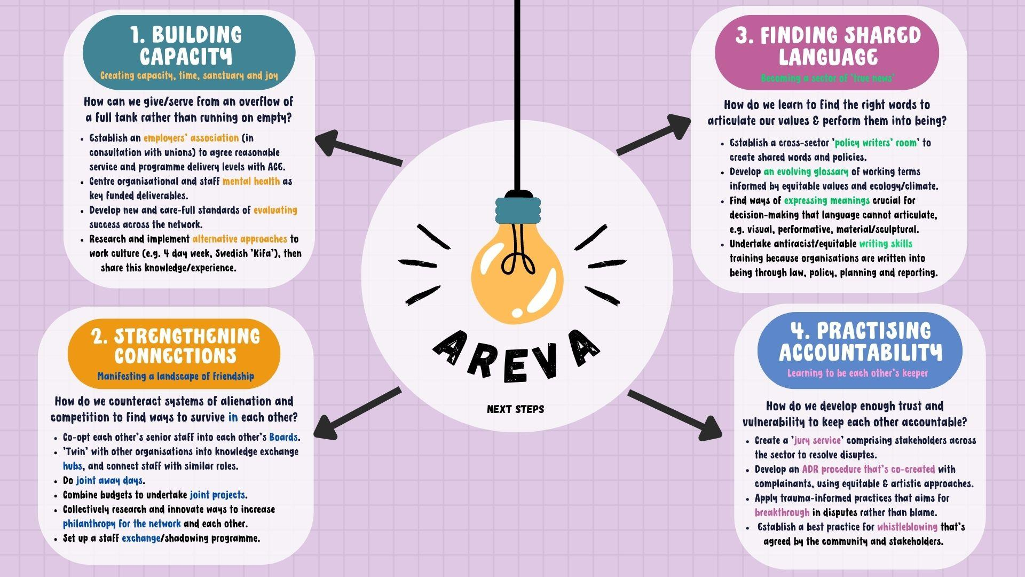

Slide 8
